Slide 1
Battle of The AI Browsers
Richard Crane

Slide 2





ABOUT THE PRESENTER
Founder/CAIO/CTO at MILL5
Worked at Microsoft for 10+ years
SQL Server Certified Master
Graduated Summa Cum Laude from Drexel University
Former Adjunct Professor at Drexel University
Authored Essential Windows Communication Foundation for Addison Wesley
Wrote Developing High-Quality Code, The .NET Way for Software Development Times (https://bit.ly/qualitycode)
richardcrane

Slide 3
What is Available?
Perplexity Comet
Claude for Chrome
ChatGPT Atlas
Chrome with Gemini *
Copilot for Edge *
* not directly discussed in this talk

Slide 4


Slide 5
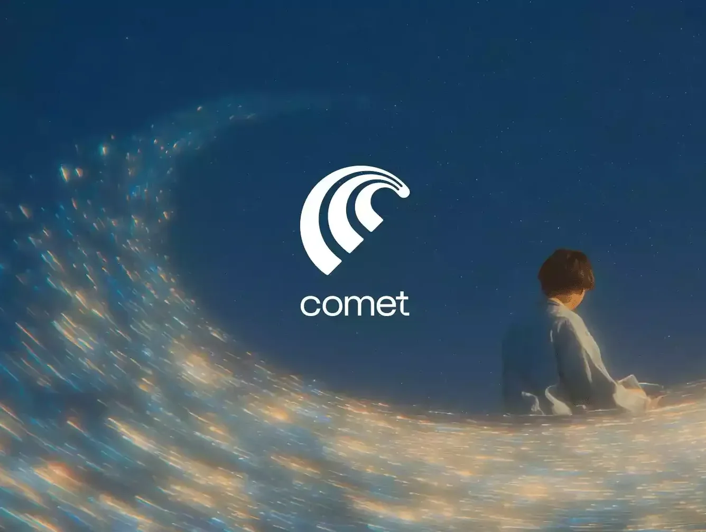
Introducing Perplexity Comet
What It Is An AI research and browsing assistant that delivers fast accurate answers with clear citations.
Why It Matters Transforms how you search summarize and analyze information directly in the browser.
Key Features
Real time search with citations
Instant summaries of complex pages
Multi step reasoning for research tasks
Smart follow up suggestions
Seamless Chrome integration
Best For Developers analysts researchers and anyone who wants trusted information fast

Slide 6
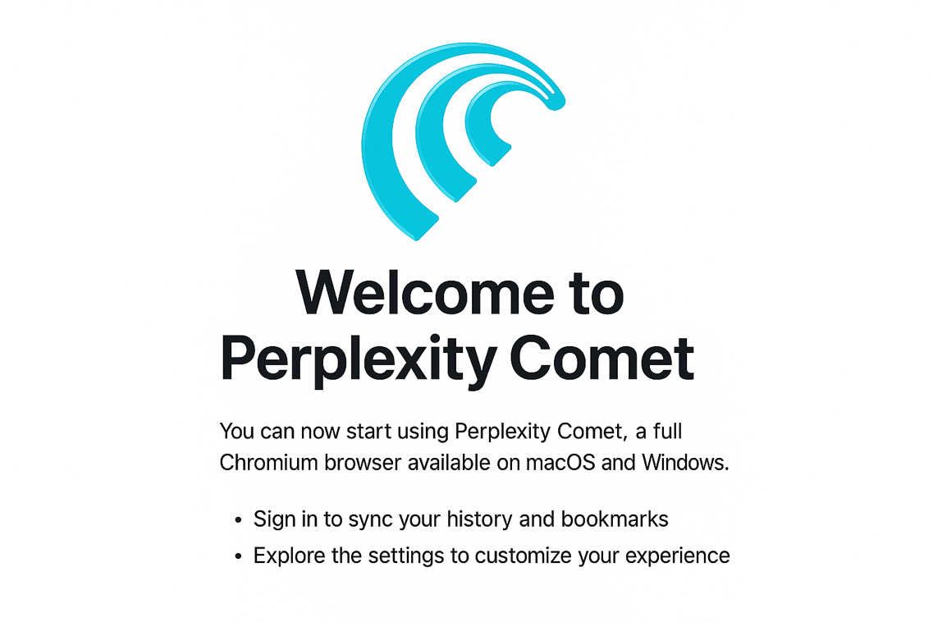
Perplexity Comet
First To Market
Free, Pro, Max, Comet Plus
Basic features enabled across all subscriptions
Comet Plus is extra features for Free subscribers
Max virtually unlimited
Available on MacOS and Windows

Slide 7

Introducing Claude for Chrome
What It Is Anthropic’s browser extension that brings Claude’s reasoning and summarization capabilities directly into your web experience.
Why It Matters Enables thoughtful analysis safe reasoning and high-quality summaries without leaving the page.
Key Features
Contextual page summaries
Structured breakdowns of complex topics
Inline writing assistance
Code review and explanation
Privacy focused design
Best For Developers writers researchers and anyone who needs clear precise reasoning in the browser

Slide 8
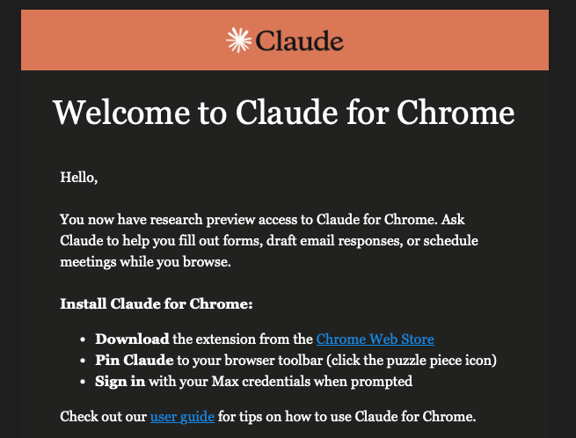
Claude for Chrome
In Research Preview
Available to Max subscribers
Supports Edge, Chrome, and other Chromium browsers
Leverages the latest Anthropic models such as Haiku & Sonnet 4.5

Slide 9

Introducing ChatGPT Atlas
What It Is A browser integrated AI assistant from OpenAI that enhances how you read explore and interact with the web.
Why It Matters Provides context aware explanations smart summaries and deep reasoning directly on top of any page.
Key Features
Page aware understanding and guidance
Instant summaries with source context
Code explanations and debugging help
Research analysis with memory and structure
Seamless Chrome integration
Best For Developers researchers content creators and anyone who wants intelligent assistance while browsing

Slide 10
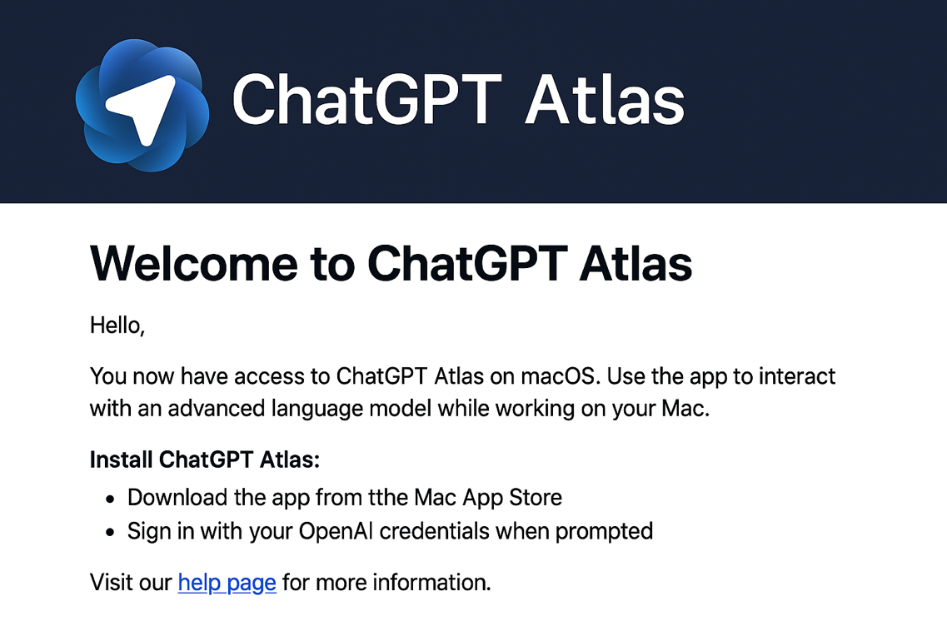
ChatGPT Atlas
Currently MacOS Only
Available to Free, Plus, Pro, and Go users
Agent Mode available to Plus and Pro users
Leverages the latest ChatGPT 5.1 model

Slide 11
THANK YOU FOR ATTENDING
Visit inventingfirewith.ai
Also on YouTube, Spotify, Apple Podcast

